Slide 1
SPREADSHEETS
3

Slide 2
Cell Range
Can you still remember what a cell range is

Slide 3
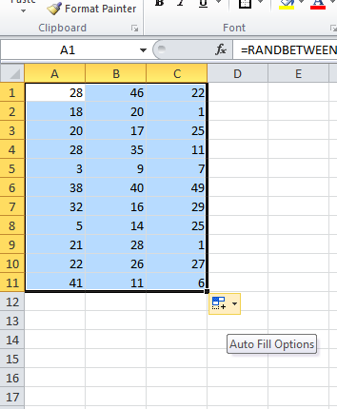
Cell Range
A cell range is a group of adjacent (together – no gaps in-between) that you can select by dragging the mouse across the numbers.

Slide 4
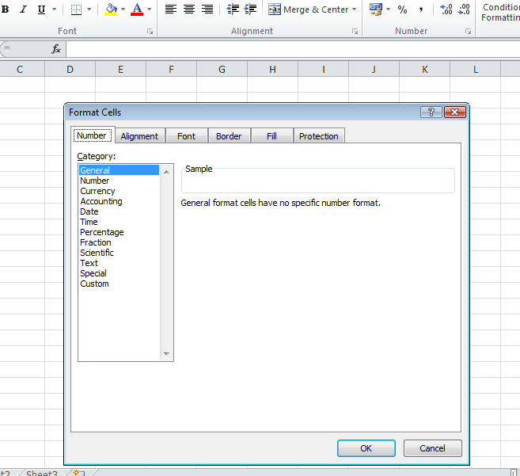
Data types
When entering a number, you can right click on it, choose format cells where after you can choose a format

Slide 5
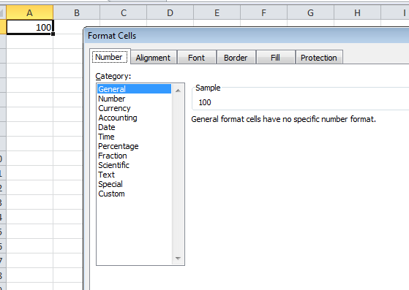
Data types - General
When clicking on General the value becomes a number

Slide 6
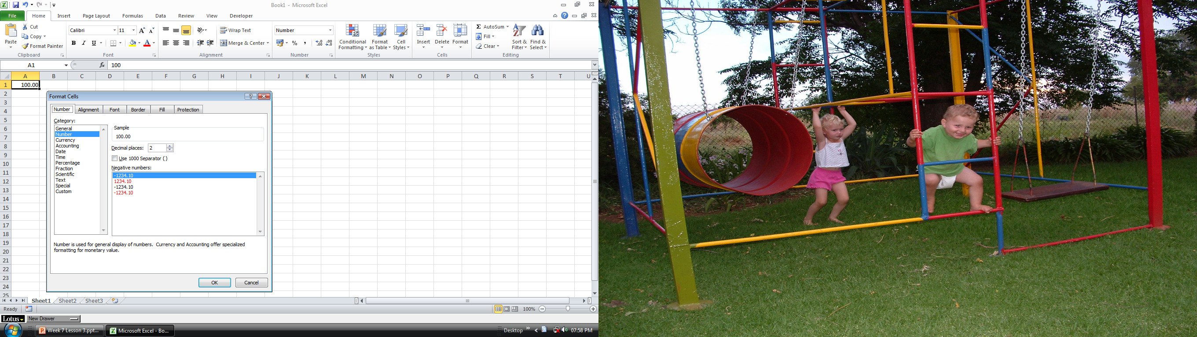
Data types - Number
When clicking on Number, you can choose how many decimal places you want, this numbers can be used in any calculations

Slide 7
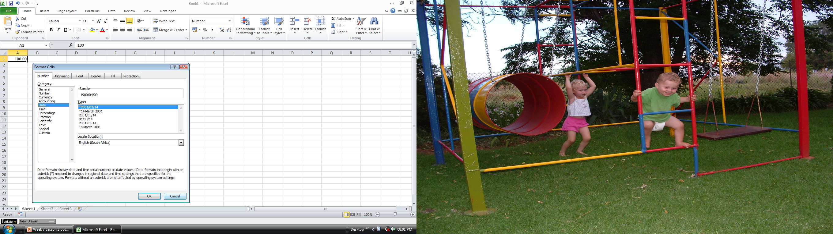
Data types – Date & Time
When clicking on Date or Time the selected value will change into the Date or Time format that you have chosen

Slide 8
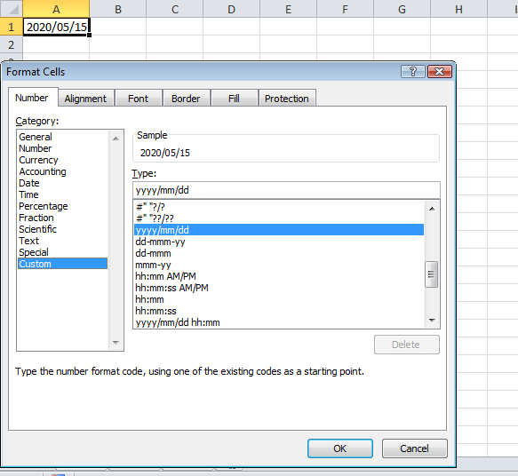
Data types – Date & Time
When clicking on Date or Time different types of dates can be selected for example
Custom dates where you can type in the date format that you would prefer for example
yyyy/mm/dd

Slide 9
Data types – Date & Time
When clicking on Date or Time different types of dates can be selected for example
Short dates for example
01/01/2015
or Long dates
01 January 2015

